Slide 1
Jordan Krutsch Personal Artwork Image Reference List
01. ABSENT [installation view] - 2016 Mixed Media
Dimensions Variable
13. Morse lights or Apathetic apology or Who could care less - 2014
clip lamps, springs, wire, false walls, Arduino Uno, Sainsmart mechanical switches, custom program Dimensions Variable
02. Drawbot 001 - 2016
repurposed microprocessor, pencils, foam, wire, glue, plastic ware Dimensions Variable
14. Morse lights or Apathetic apology or Who could care less - 2014
Video Documentation (Link) https://player.vimeo.com/video/248992265
03. ABSENT Installation - 2016 Video Documentation (Link)
https://player.vimeo.com/video/198776272
15. Dream Home - 2016 painted steel
76” x 53” x 30”
04. Drawings from ABSENT[10.12.2016] - 2016 mdf frames, prepared hardboard, graphite 8’ x 2’ x 1.5”
16. Blankscape (iteration #1) - 2015
mdf, low fire slip cast ceramic, poplar dowels Dimenstions Variable
05. I do not leak, navigator; You leak (iteration #2) - 2017 plywood, electric motors, ™Salad Shooter, foam rollers, ink, paper, extension cords, belts, motion sensor lights, button, brushes, mechanics, hardware, wires, things happening, participant
Dimensions Variable
17. Collapse - 2015
Video Documentation (Link) https://player.vimeo.com/video/248991156
06. I do no leak, navigator; You leak (iteration #1) - 2016 Video Documentation (Link) https://player.vimeo.com/video/198775236
18. Control - 2016
cast Iron, found log, rope, hardware 9’2” x 11’8” x 10”
07. A waste of time and energy - 2016
rheostat, found d.c. motor, ™Sears Kenmore motor, clock, mdf, hardware, wires
Dimensions Variable
19. Swoosh - 2012
cast aluminum, white oak, hardware, oiled steel 53” x 38” x 33”
20. Burst - 2015/16
cardboard, hot glue, monofilament 16’ x 25’ diameter
08. Charcoal delivery device #1 - 2016
wood, ™Cuisinart electric carving knife, cast iron, casters, string, rubber hose fitting, cheese cloth, charcoal, extension cords
Dimensions Variable
09. You sing, I dance (iteration #2 - Roger Miller) - 2017 wood, ™Cuisinart electric carving knife, cast iron, casters, string, rubber hose fitting, cheese cloth, charcoal, extension cords, ™Sears Kenmore motor, cone, karaoke machine, headphones, ‘You can’t rollerskate in a buffalo herd’ and ‘King of the road’ by Roger Miller, various hardware, prepared surface, ratchet straps, participant
Dimensions Variable
Roger Miller – King of the Buffalo - 2017
graphite on prepared board, ratchet straps, fixative 8’ diameter x 4” thick
You sing, I dance (Iteration #1 - Happy Birthday) - 2016 Video Documentation (Link) https://player.vimeo.com/video/198782932
A restraint of process - 2015
hand woven cargo net, hardware, 1,000lbs coke 4’ x 8’ x 1’

Slide 2
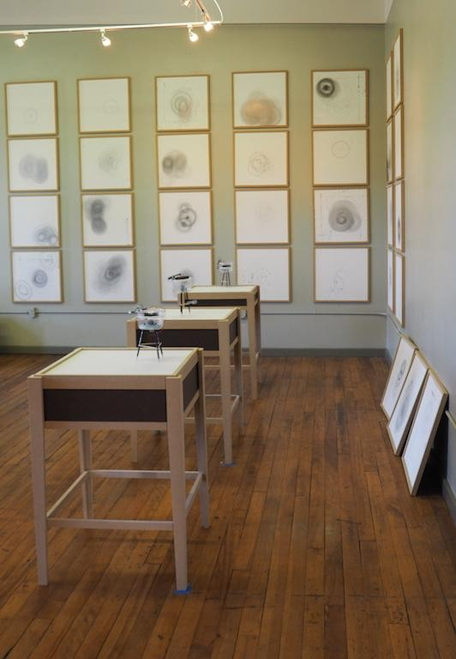

Slide 3
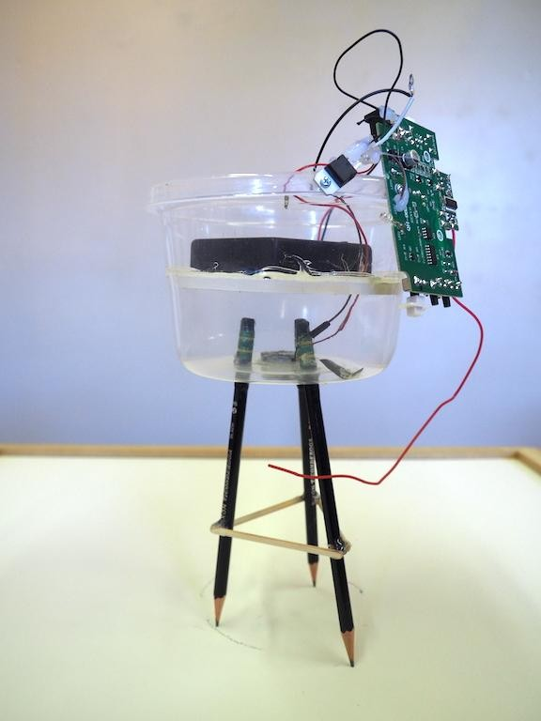

Slide 4
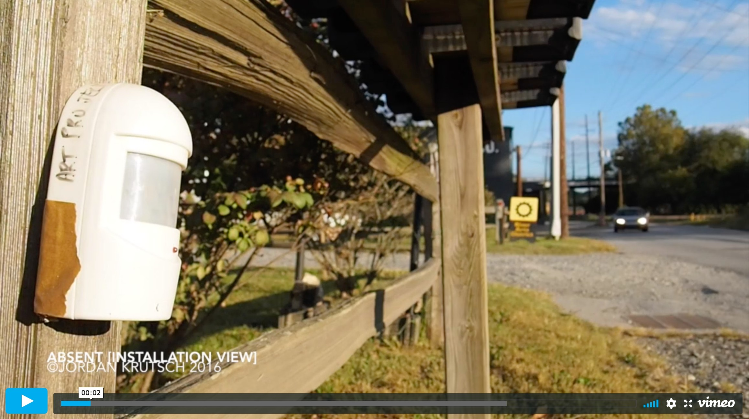
Link to Video Documentation of ABSENT Exhibition:
Please Click The Image for Video

Slide 5
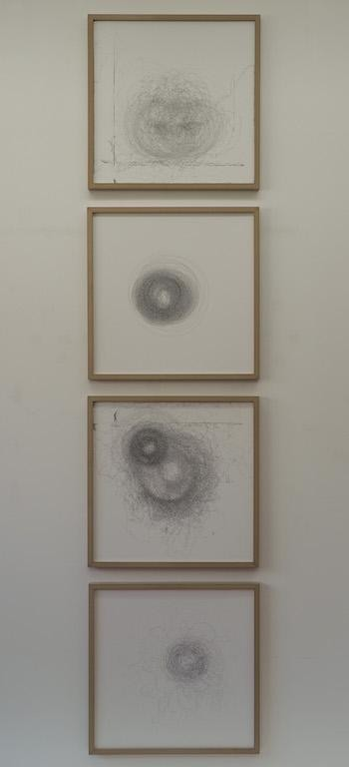

Slide 6
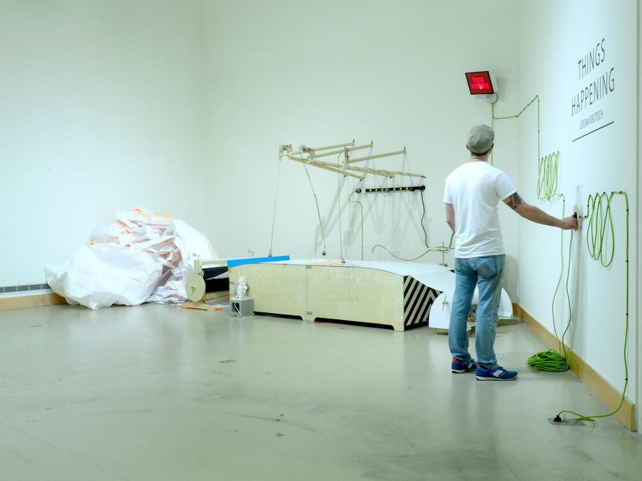

Slide 7
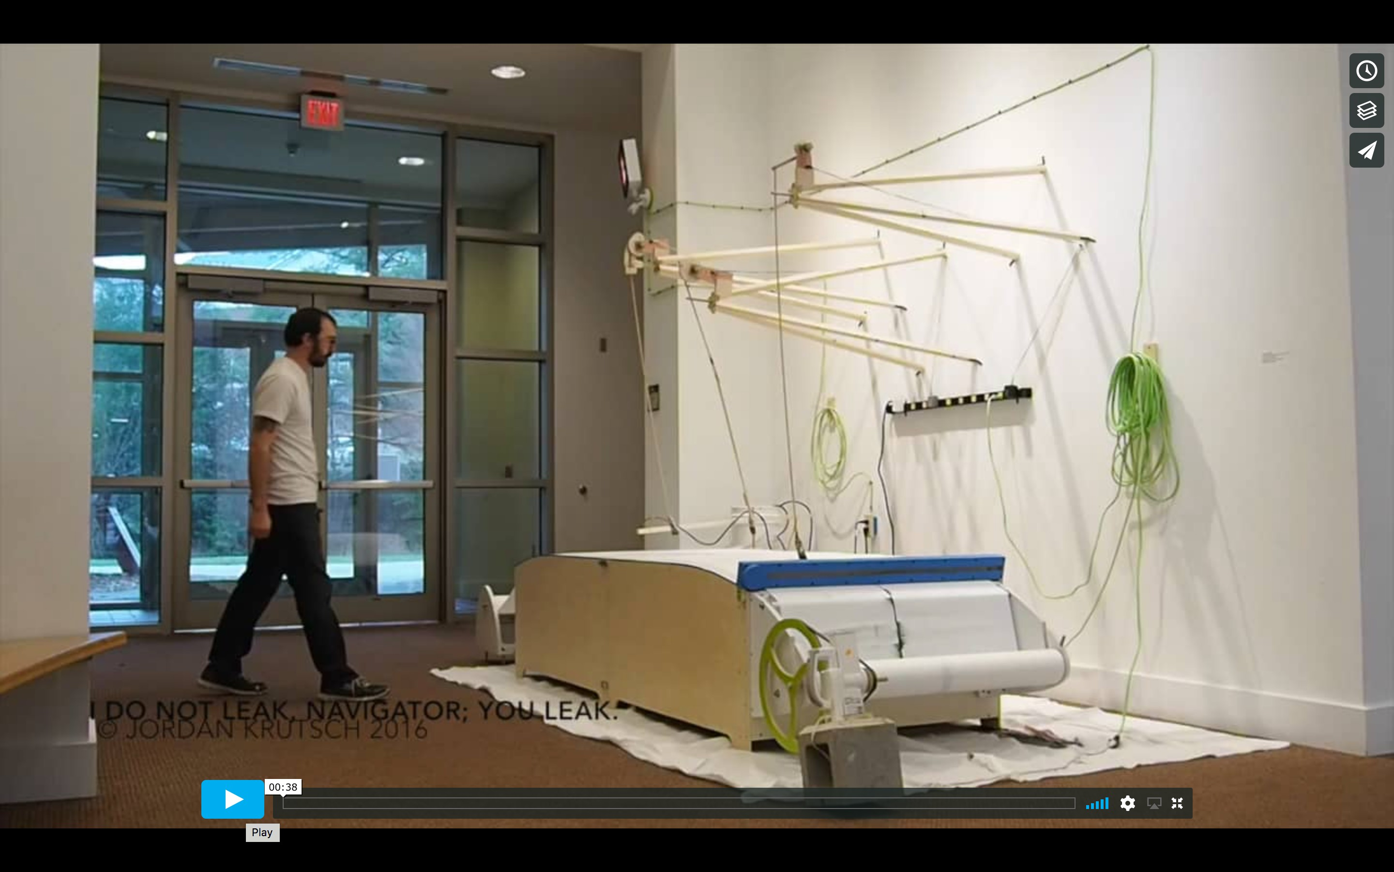
Link to Video Documentation “I do not leak, navigator; You leak” :
Please Click The Image for Video

Slide 8
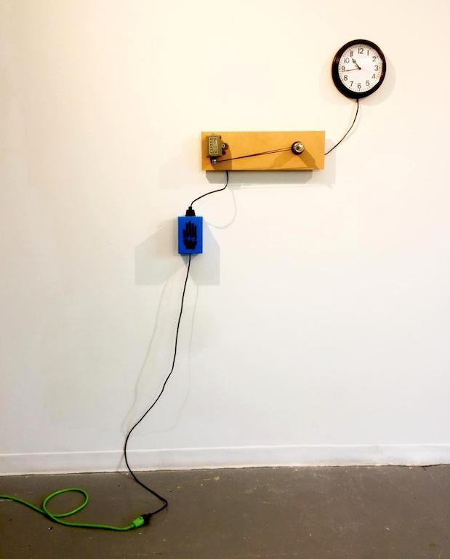

Slide 9
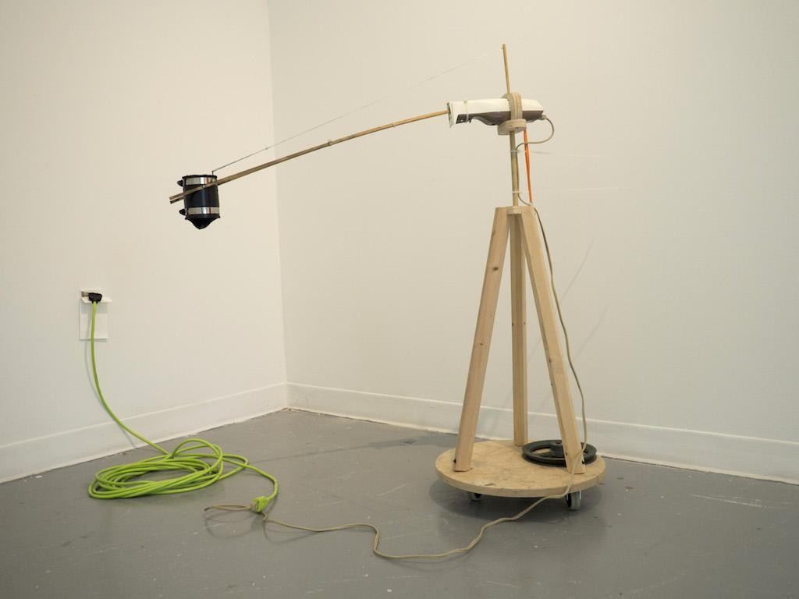

Slide 10
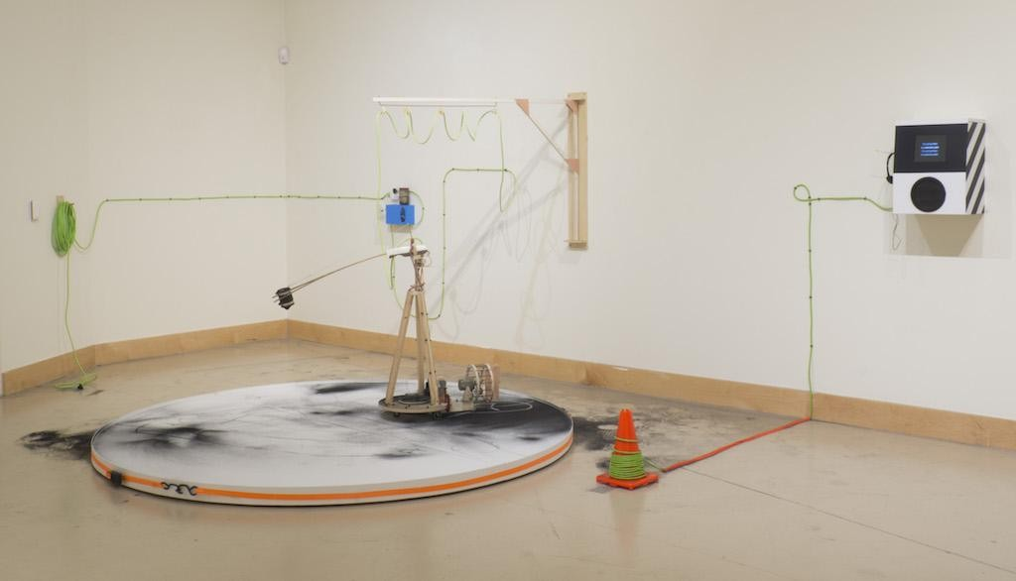

Slide 11
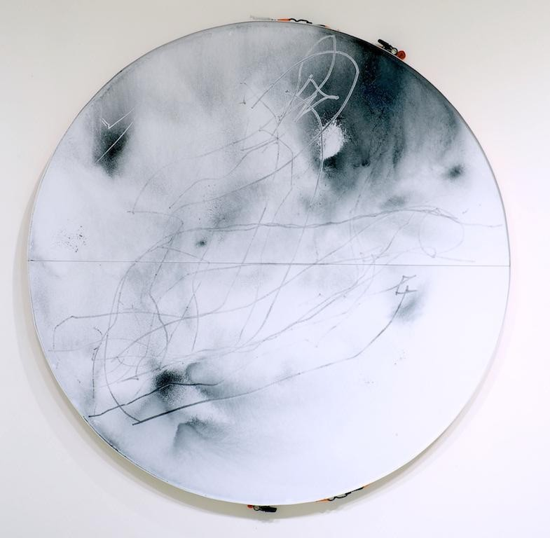

Slide 12
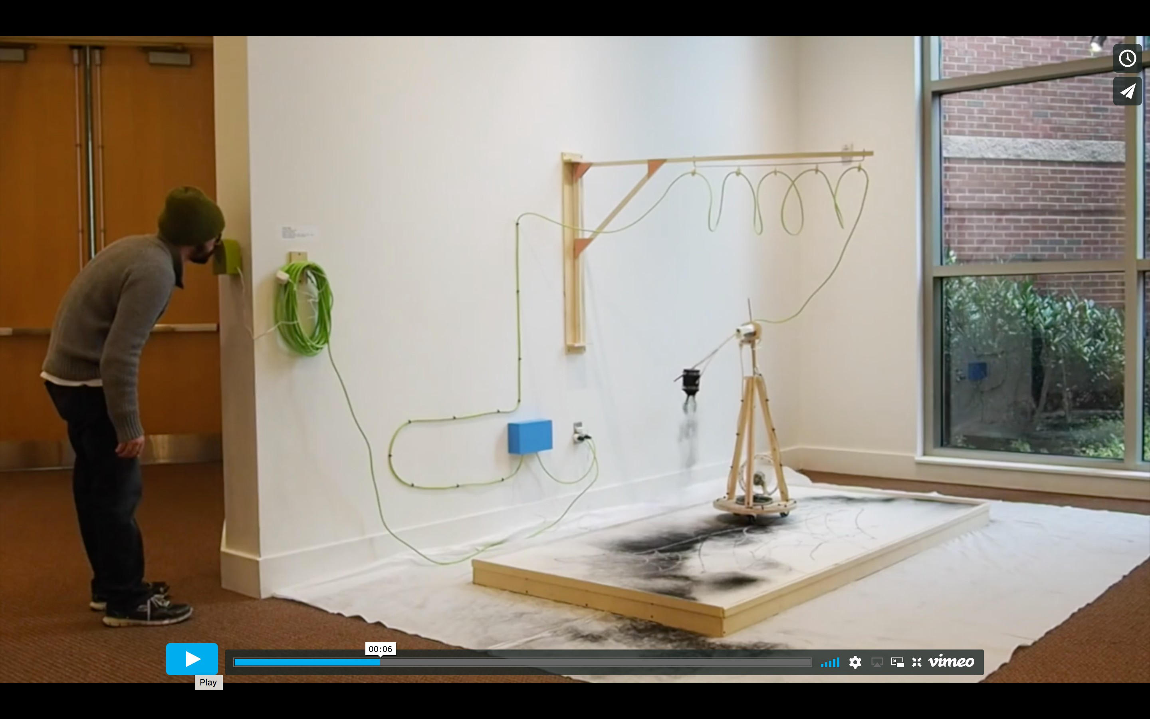
Link to Video Documentation “You sing, I dance”:
Please Click The Image for Video

Slide 13
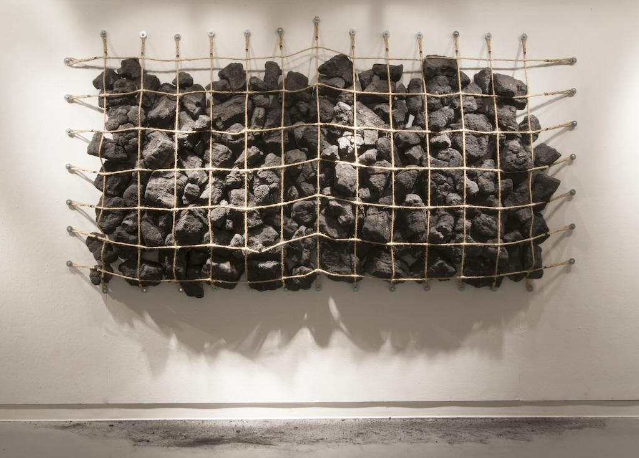

Slide 14
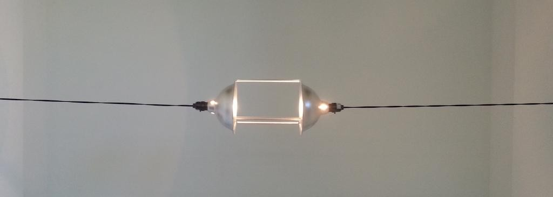

Slide 15
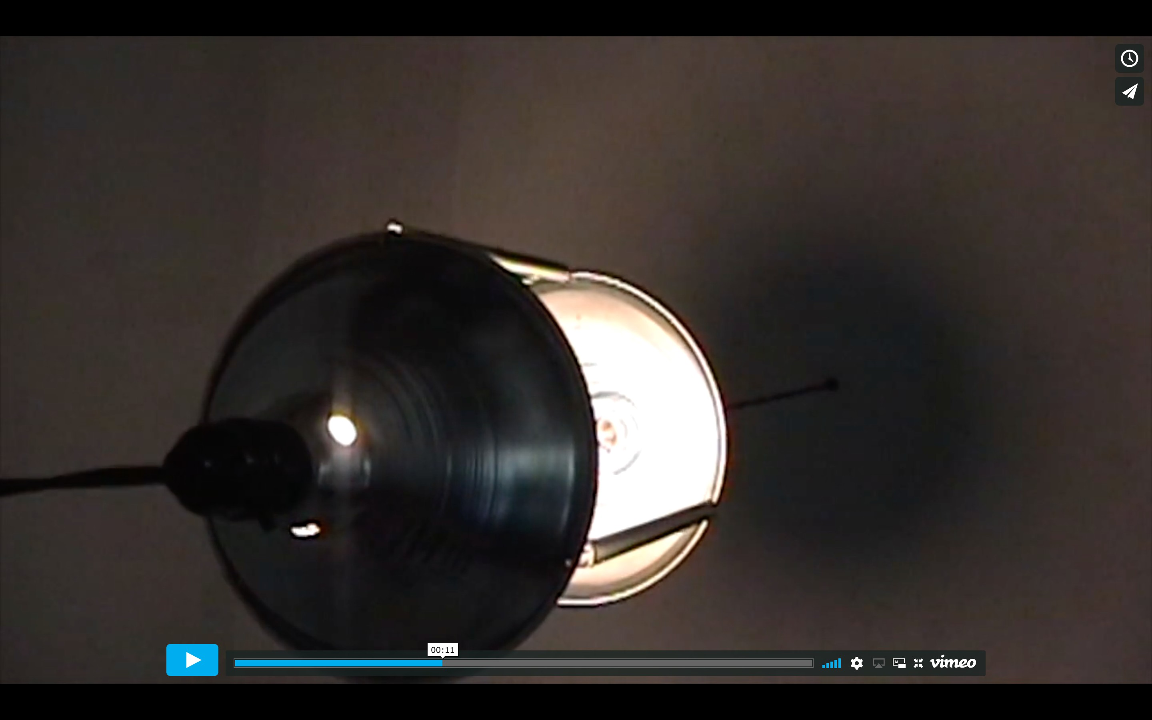
Link to Video Documentation “Morse lights” or “Apathetic apology” or “Who could care less”:
Please Click The Image for Video

Slide 16
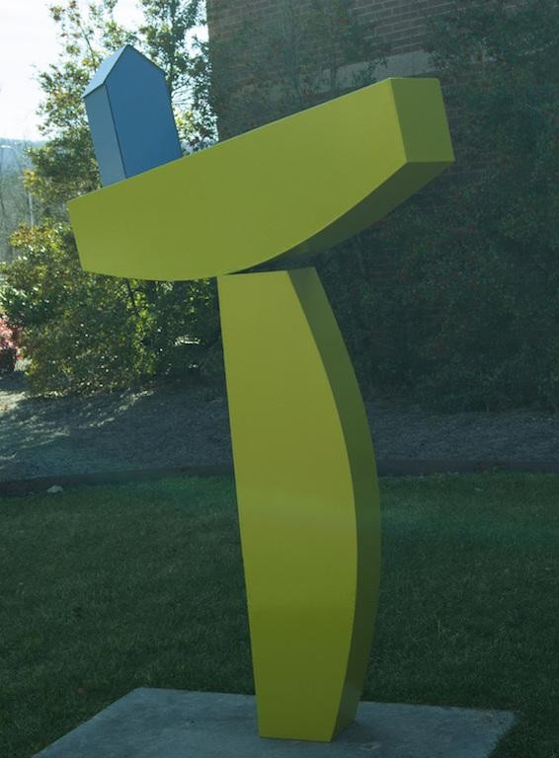

Slide 17
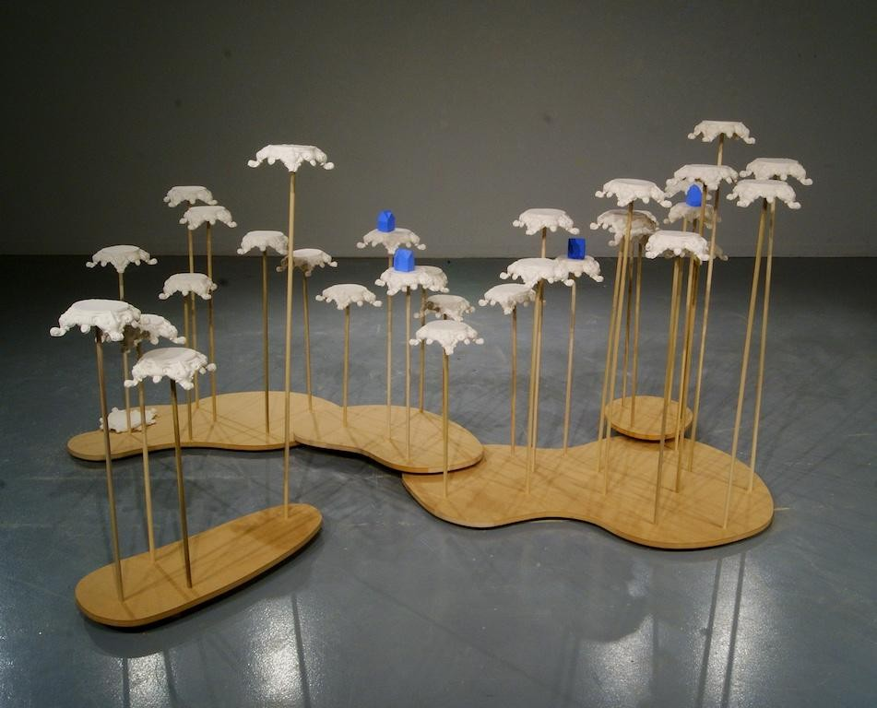

Slide 18
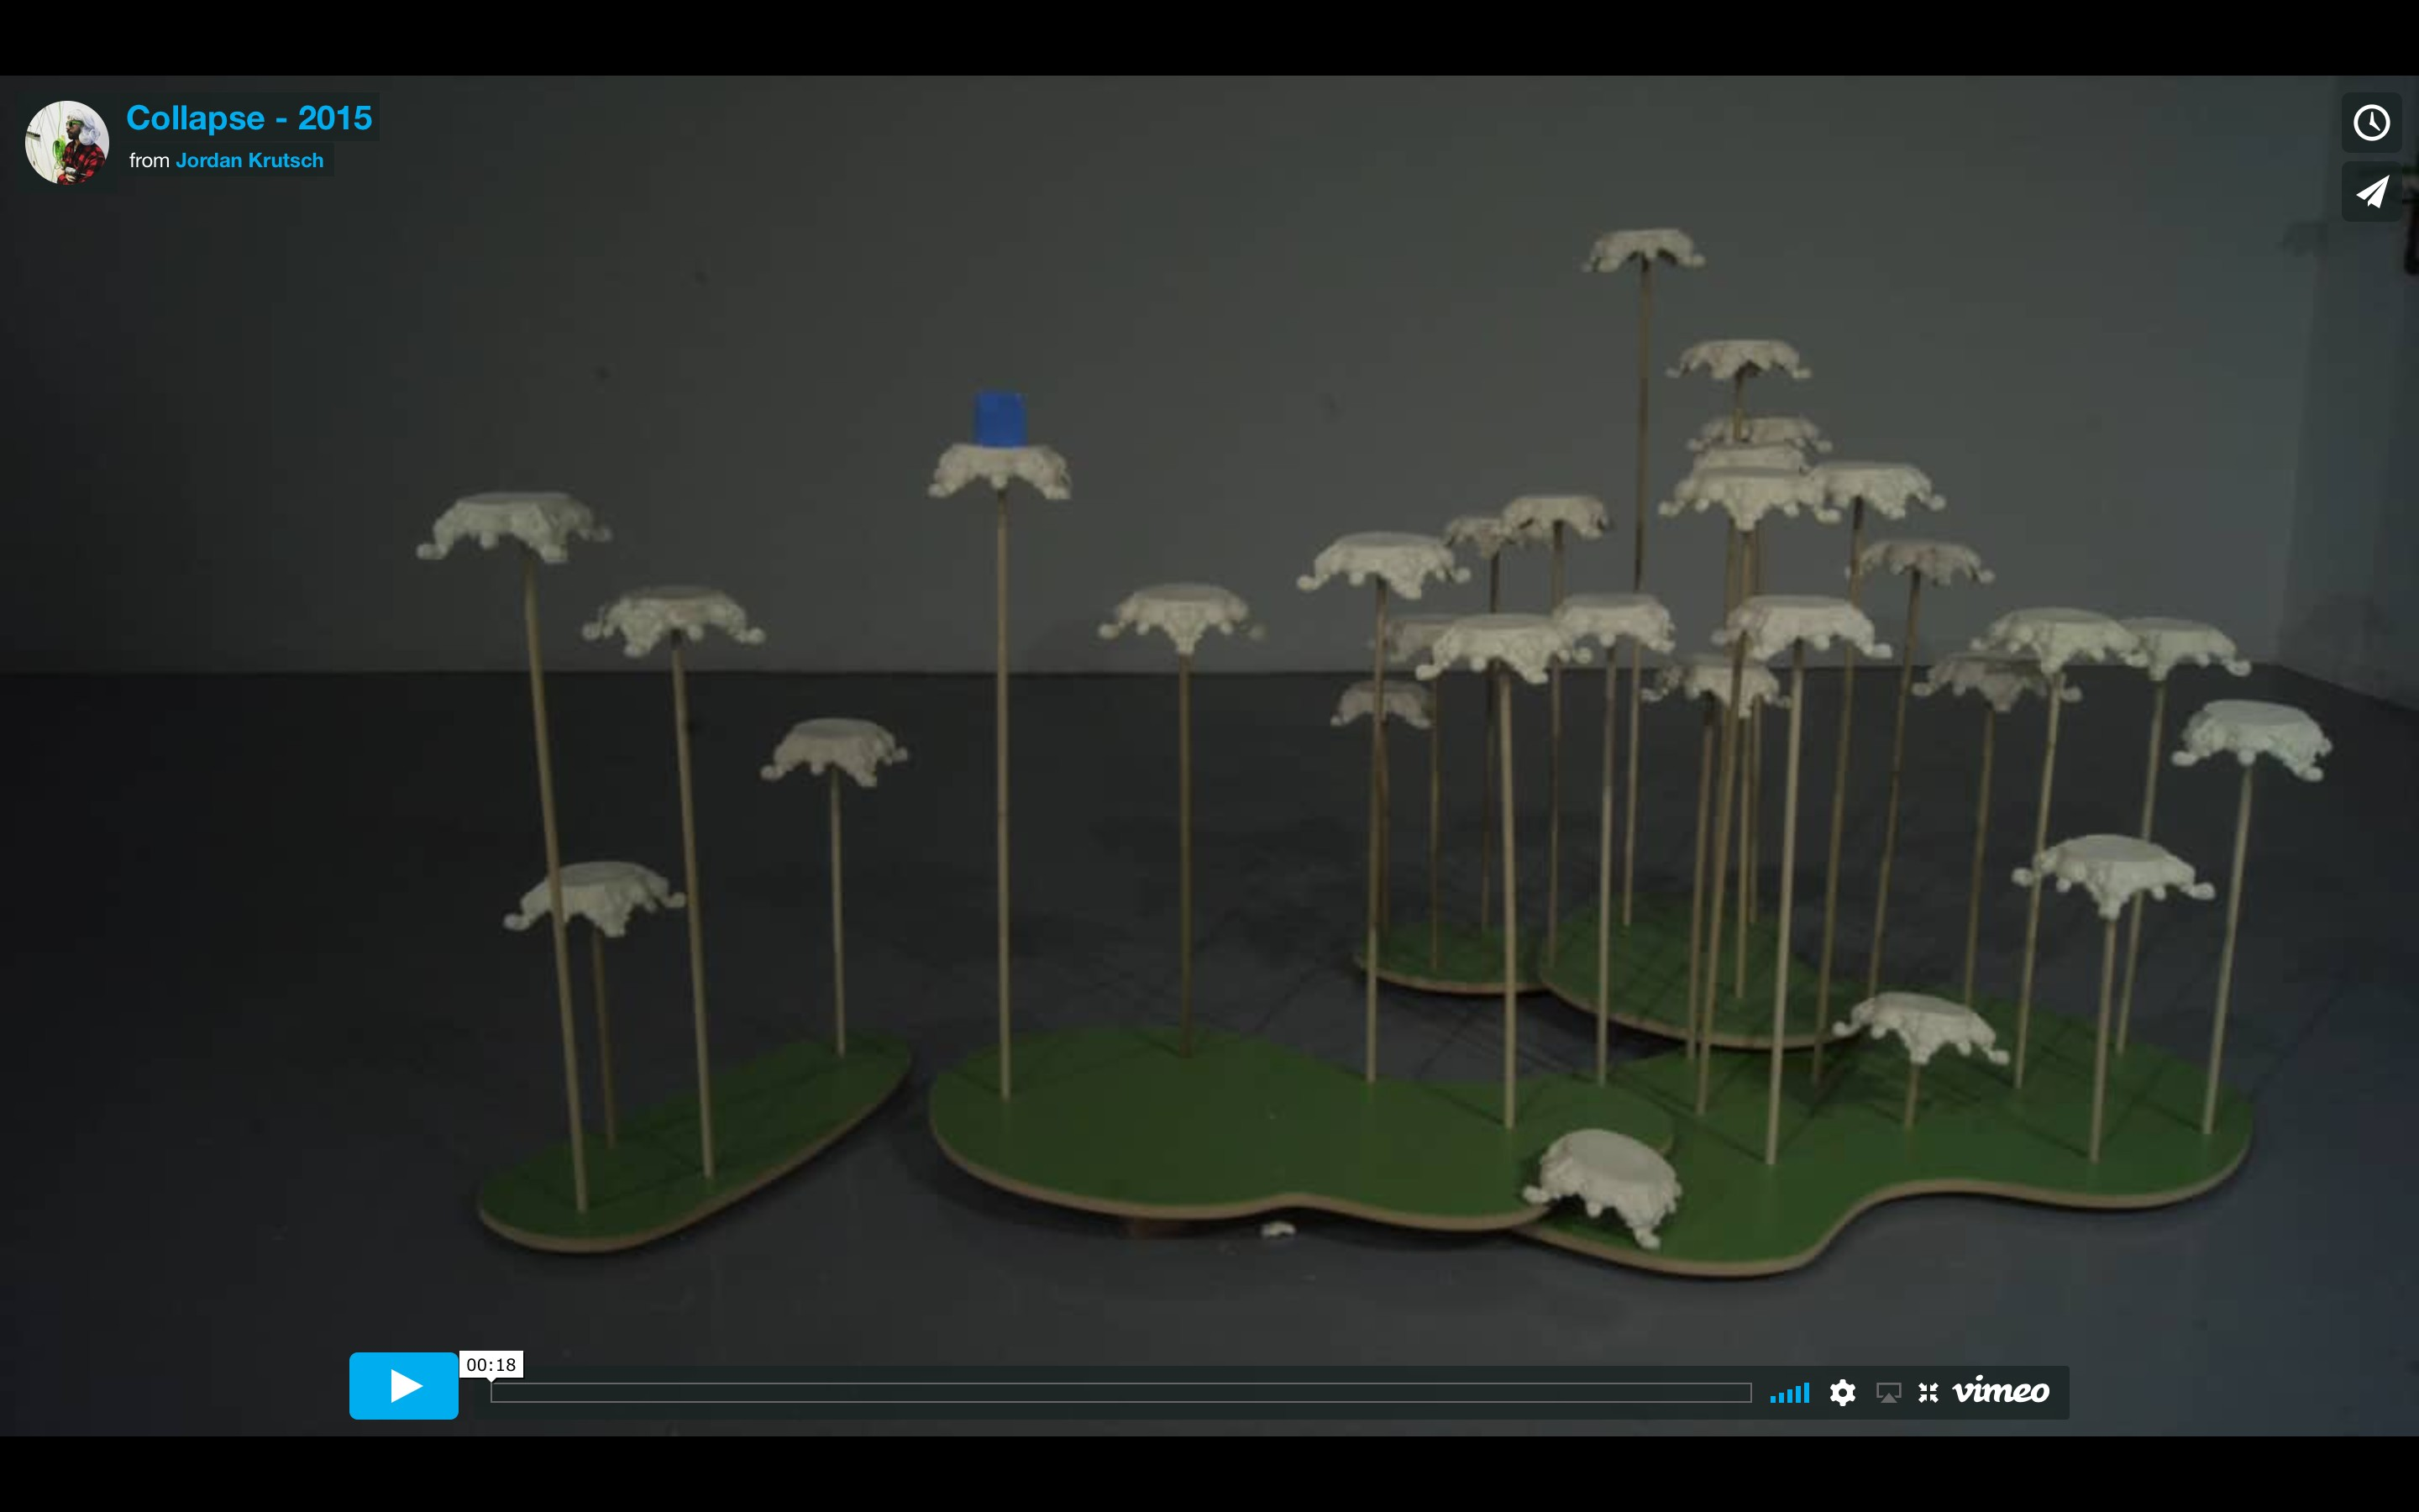
Link to Video Documentation “Collapse”:
Please Click The Image for Video

Slide 19
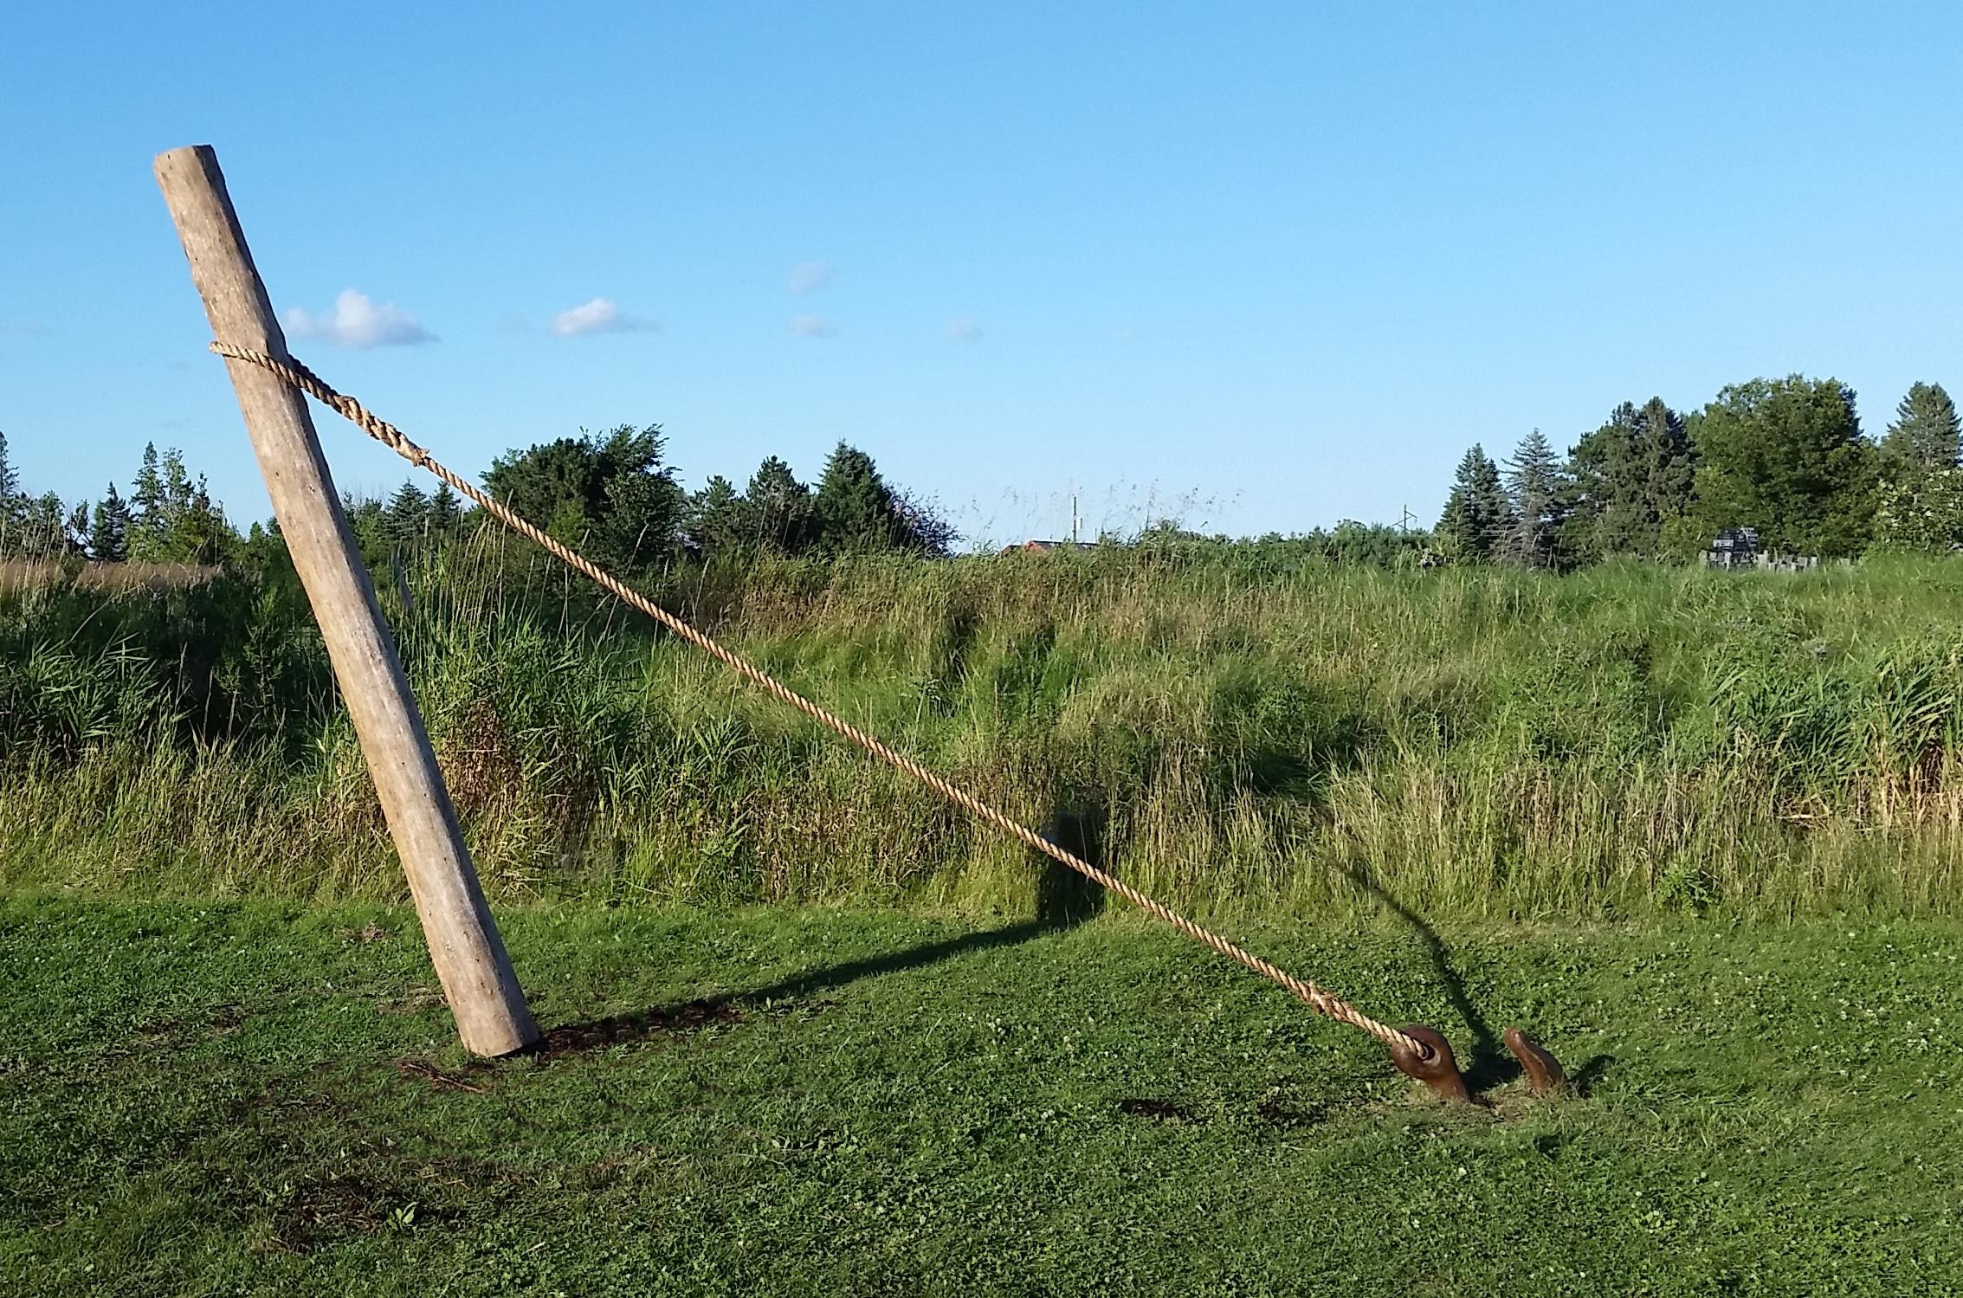

Slide 20
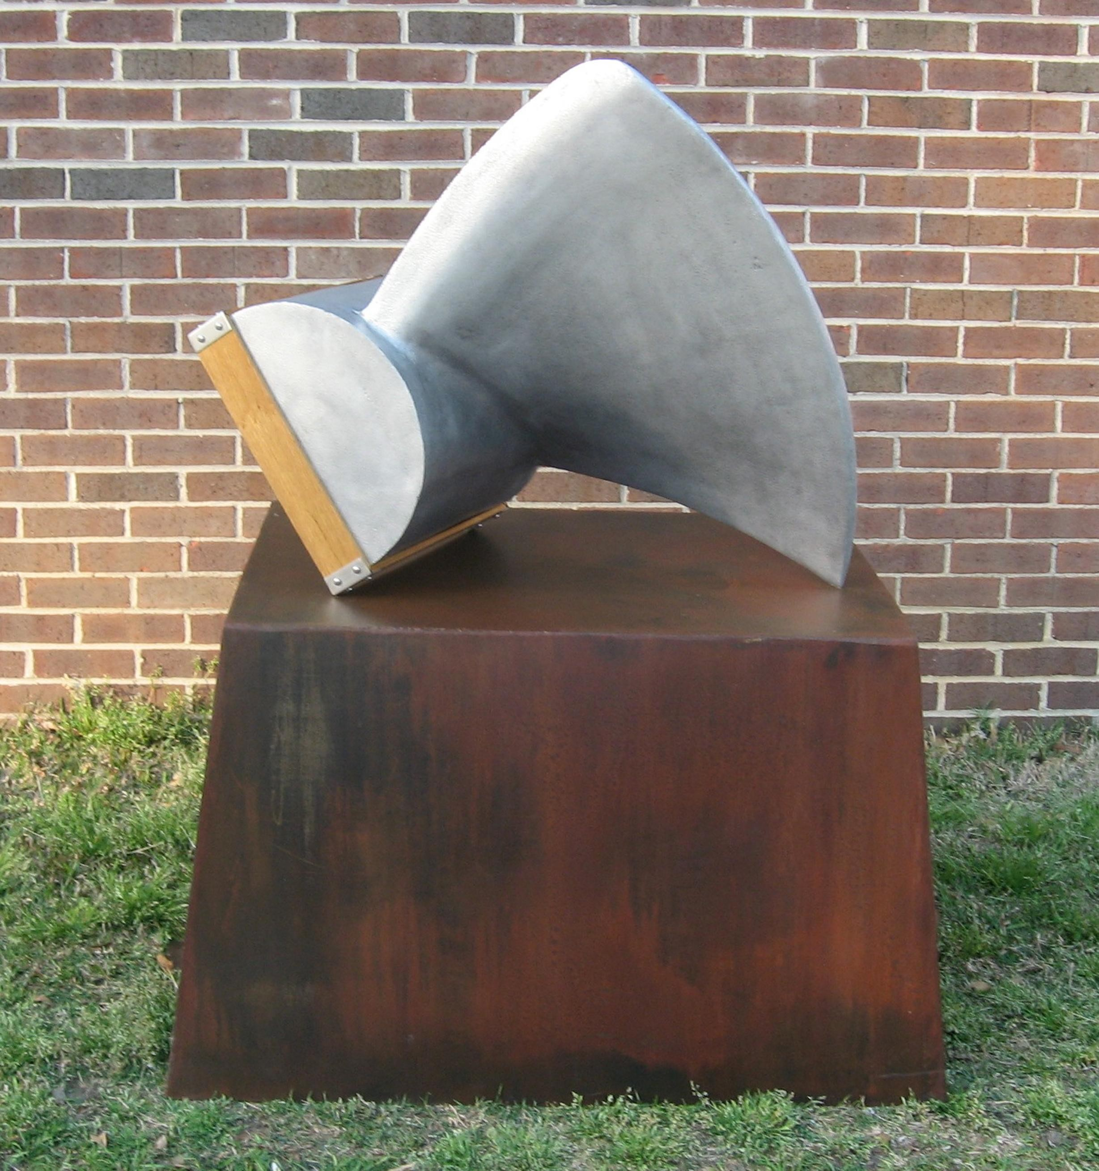

Slide 21
